Slide 1
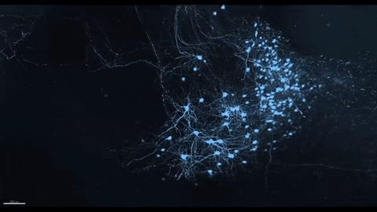
Neural Architectural Search using Parameter Sharing and Augmenting
Memory Models.
-Vinay Jain, Graduate Student, Data Science
Advisor: Dr. Travis Desell

Slide 2
What is Neural Architectural Search(NAS)?
It is a subset of AutoML: The process of automating machine learning task.
  Automating Data Preparing, Feature Engineering, Model Assembling.
NAS deals with the issue of Model Assembling.
  Which includes model structure, choosing hyperparameters, activation functions.
It can be formulated as selecting a model from a set of all model possible such as to minimize the loss function on validation set.
Example :
  Suppose we need to transport in desert. So of all the working animals: dog, horse, camel and cattle. We select camel.(Model Selection).
  Now, what If we make our own animal best suitable for the transporting in desert. (Model Generation).
  Lastly, what if we automate the task of making our own animals. (Automation).

Slide 3
What is AutoML?
Automated Machine Learning provides methods and processes to make Machine Learning available for non-Machine Learning experts, to improve efficiency of Machine Learning and to accelerate research on Machine Learning.
  Pre-process and clean the data.
  Select and construct appropriate features.
  Select an appropriate model family.
  Optimize model hyperparameters.
  Postprocess machine learning models.
  Critically analyze the results obtained.
The field of architecture search addresses the problem of finding a well-performing architecture of a deep neural network. For example, this includes the number of layers, number of neurons, the type of activation functions and many more design decisions. Automated architecture search can substantially sped up the development of new deep learning application as developers do not need to painstakingly evaluate different architectures.

Slide 4
Goals of this Project
Automating the designing and development of neural architecture using neural architectural search and neuro-evolution.
Implementing a novel approach based on EXAMM(Evolutionary eXploration of Augmenting Memory Models) and ENAS(Efficient Neural Architectural
Search).
Evaluating results on benchmark datasets like Coal Datasets (2018_coal), Aviation Dataset (2018_ngafid), Engine Dataset (2020_engine_wind) for Regression based models.
Similarly, evaluating on text model datasets such as PennTree Bank ( Character Level and Word Level) and WikiText Bank ( Word Level on paragraph basis).

Slide 5
Current State of the Project
We found that Neuro-Evolution based algorithms works better in finding macro architectures as compared to Reinforcement Learning based algorithms.
Based on this hypothesis, we develop multiple memory cells using ENAS algorithm, on coal datasets.
Then, implementation the memory cell for the EXAMM to develop the macro-architecture to give the final output.

Slide 6
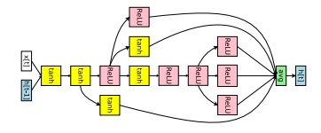
Current State of the Project
In order to apply the gradient descent on multiple generated memory cell, we implemented a auto gradient module that can forward propagate and backpropagate any given cell with structure ( Node, Operation).
Therefore, It is a Directed Acyclic Graph with n – 1 node edges with 3 operations choices names tanh, ReLU, identity.
For example, [0 2 1 0 2 1 2 2 4 0 5 0 3 2 6 2] means

Slide 7
Current State of the Project
Implementation of data module to handle text datasets such as penntree bank and wikitext on single character and single word level with variable offset.
It can handle multiple files, sentences, paragraphs as the size of input.
Adding the softmax layer for the purpose of classification based problem.

Slide 8
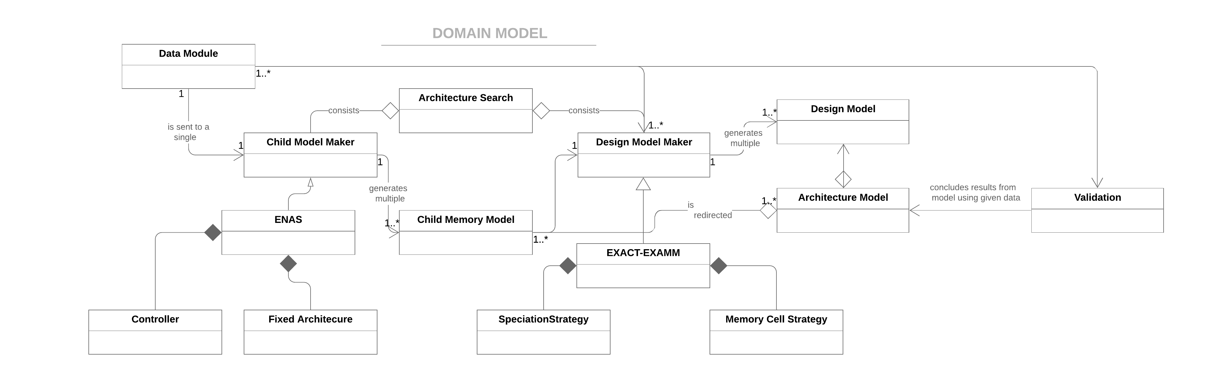
Domain Model Diagram
Overall Architecture consist of:
  Memory Child Maker
  Design Model Maker
Child Model Maker gives memory model for Design Model
A single Design Model can consist of multiple same child models.

Slide 9
Domain Model Diagram
Child Model Maker is a module for making memory model for entire architecture model.
We can use any memory model method which will satisfy child model interface.
We use ENAS for making memory model.
ENAS has two modules based on RL:
Controller ( Generates multiple memory cells for the fixed architecture)
Fixed Architecture ( Test the multiple memory cells to give the output).
Child Model Maker will give top 10 performing memory models as outputs to use.

Slide 10
Domain Model Diagram
The final architecture model consists of Child Memory Model and Design Model.
The Architecture Model is then passed to Validation to get the final output on dataset.
It would test on the testing data and give the predictions.
EXAMM uses speciation strategy based on neuroevolutionary algorithms such as island selection and asynchronous crossover and mutation.
In crossover : using two macro architecture as parent to create an new architecture as offspring.
In mutation : Diversifying the memory cell from the previous generation by changing the memory cell.

Slide 11
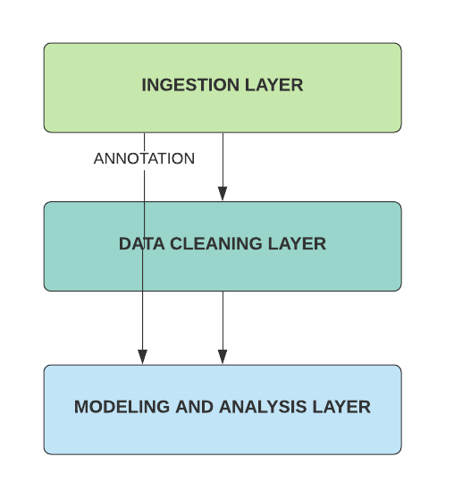
Architecture Overview
Storing the time series dataset and text dataset into training, validation and testing set in pickle files.
Transforming the text dataset using embedding, indexing and One-Hot Encoder.
Developing Architectural Model and analysis of the result.

Slide 12
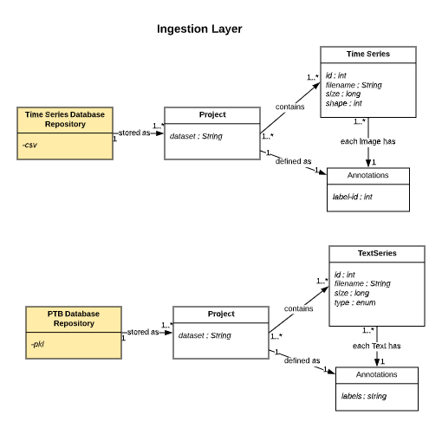
Architecture Overview
Time Series Database and PTB database is used.
Data is divided into training, testing and validation.
For time series, based on the parameter, output variable is selected.
For text series, word-offset is passed and type is passed to predict.
The labels for the character and word level would be characters and words from the next word offset.
The module for the PTB character can also handle PTB word level prediction.

Slide 13
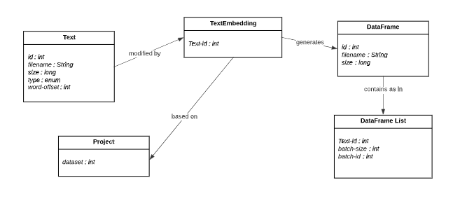
Architecture Overview
Text data is embedded as array, text index.
Different algorithms can be used for embedding.
Each dataset is divided into batch size, sentences, paragraph based on the type.

Slide 14
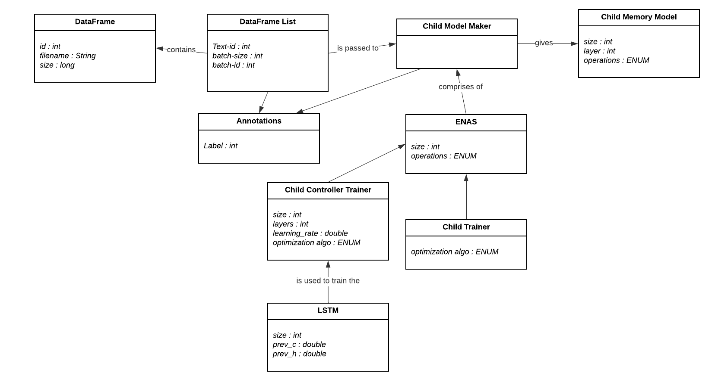
Architecture Overview
Child Model Maker takes in data frame and annotation as input.
ENAS uses an controller and child trainer to output a child memory model.

Slide 15
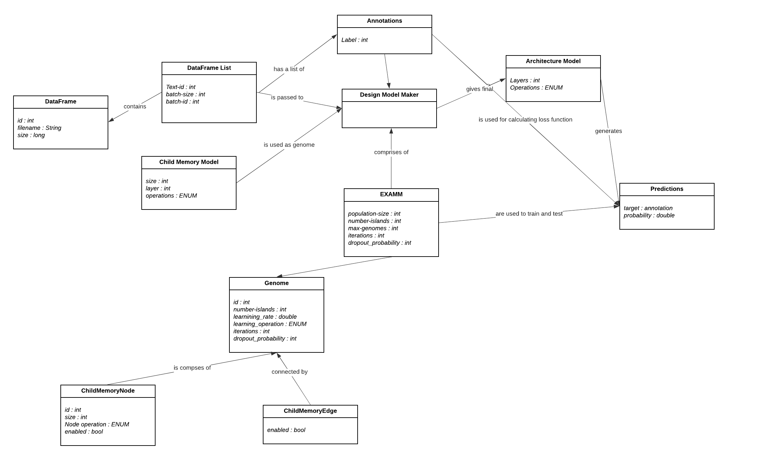
Architecture Overview
Design Model Maker takes in Data Frame, annotation and child memory model as input.
It uses EXAMM as the underlying model to generate architecture model.
Genome are memory models with nodes and edges.
Final Architecture consist of design model comprising of child memory models.
Predictions are done on final architecture.

Slide 16
Deliverables
For this semester,
  For the first task, we implement the regression based algorithm for the ENAS algorithms on tensorflow.
  Implementation of data modules for time series on ENAS.
  Currently, ENAS can only handle Text Classification and Image Classification.
  This will help us compare the EXAMM and ENAS macro architecture on Coal dataset, Aviation dataset and Engine dataset.
  Finally, statistically comparing the result over 20 iterations using 2000 genomes.

Slide 17
Deliverables
For this semester,
  For the second task, we improvise the text module in EXAMM module to decrease the work load on CPU.
  Implementation of batchify function to fix the time sequence .
  Currently, EXAMM can only handle file level text input thus creating a very huge workload on CPU.
  This will help us compare the EXAMM and ENAS macro architecture on PTB and wikitext dataset.
  Finally, statistically comparing the result over 20 iterations using 2000 genomes.
  Implementation of Classification based model on EXAMM.

Slide 18
Deliverables
For this semester,
  For the third task, we implement the genetic algorithm module for the memory cells developed.
  Currently, EXAMM takes in predefined memory cells to evolve macro architecture.
  At present, memory cells are randomly generated using mt19937.
  Auto Gradient is implemented to test all the memory cells generated.
  To test the memory cells, predefined macro architecture is used during initialization phase.

Slide 19
Things done till now.
Module for the NLP for the neuroevolution is completed and the passing the data into the neural networks is completed using batchify in the sets of 32, 64 and 128 for character, word prediction. The results are character is completed. The word prediction is completed and the results are still in progress due to size of the data input.
The first part of the getting random neural networks memory cell are already done and the architecture is separate will done separately. Currently we can run random neural networks on EXAMM.
The data input for the ENAS is done and the controller part of the regression based ENAS for comparison is done. The final attention based class for the getting the final regression output is still remaining.
The paper result till now has been positive.
Finally, due to lack of knowledge in NLP and attention based networks, the regression based implementation has ben delayed.
The WikiText prediction is done in batches with same format as word prediction as PTB as there are no concrete format of the input size and the length.

Slide 20
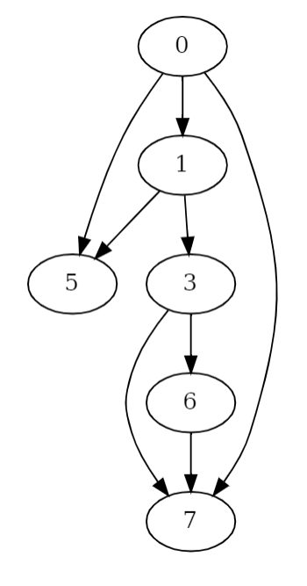
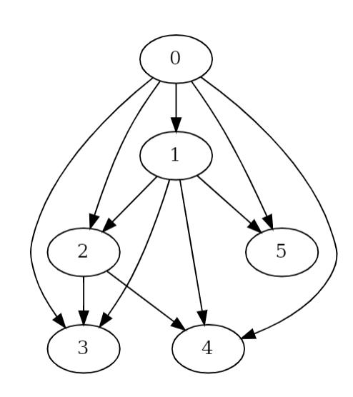
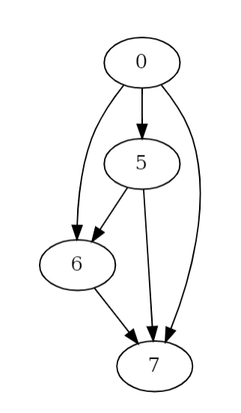
Results of the Project
We further improve this auto gradient architecture to inhibit multiple source multiple node connections that increases the search space of the memory cells possible. This helps increase the connections to ( N*N-1) and operations to 5 ( Tanh, sigmoid, ReLU, LeakyReLU and swish)
The new operation swish has shown better results as compared to sigmoid since the final memory cell with the best result contains swish operation. ( h* sigmoid)

Slide 21
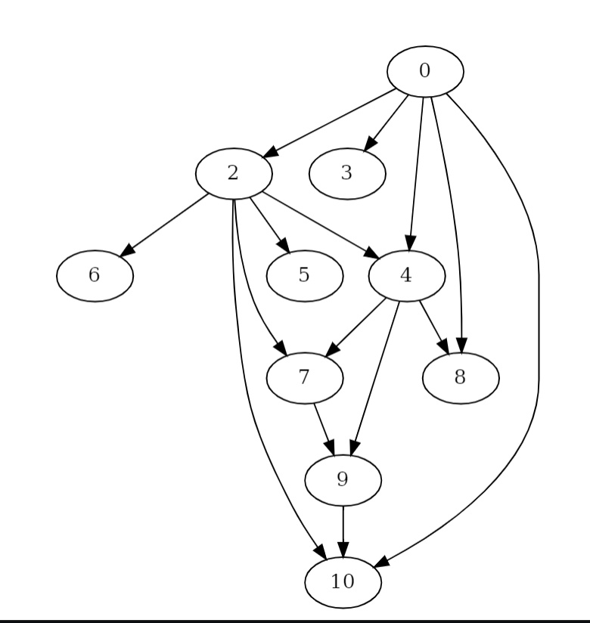
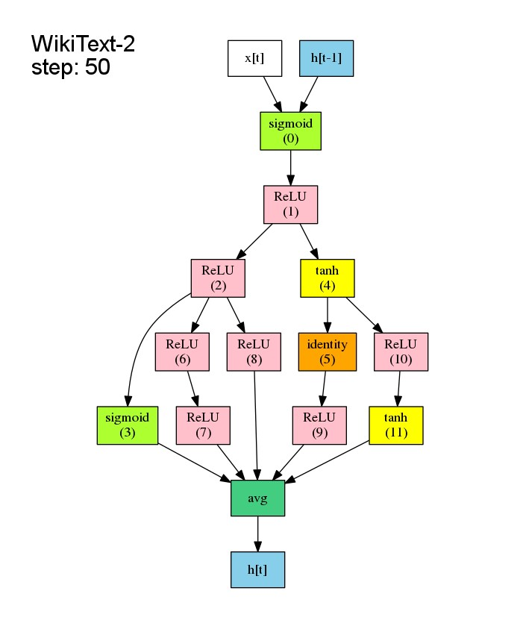
Results of the Project
Connections : {0,1,1,1,2,5,3,5,4} and Operations : {1,1,1,3,3,0,2,1,2}
To
Connections : {
{0,0,0,0,0,1,1,1},
{0,0,0,0,0,0,0,0},
{0,0,0,0,0,0,0,0},
{0,0,0,0,0,0,0,0},
{0,0,0,0,0,0,0,0},
{0,0,0,0,0,0,1,1},
{0,0,0,0,0,0,0,1},
{0,0,0,0,0,0,0,0}
};
And Operations: {1,1,1,3,3,0,2,1,2};

Slide 22
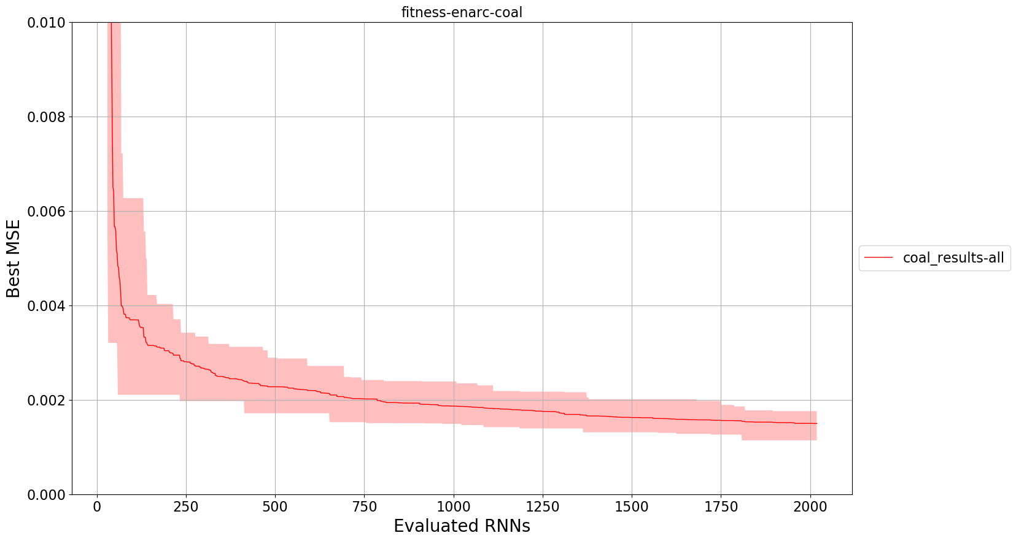
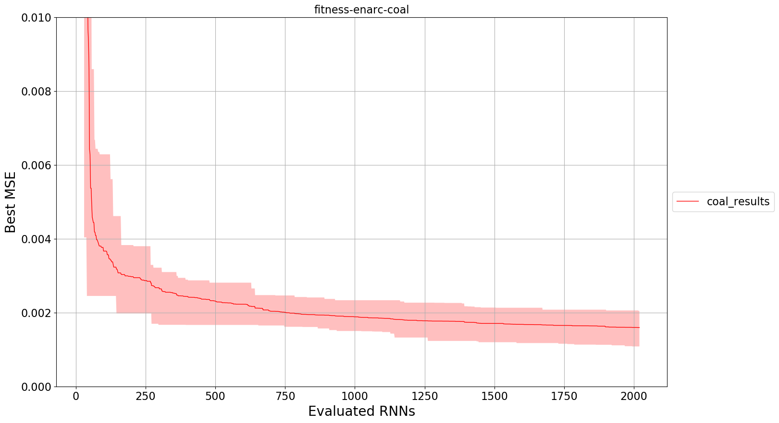
Results of the Project
After Testing using all the cells and only the new node, we found that using all the memory cell as compared to only a single cell performs better with smaller std.deviation.

Slide 23
Results of the Project
On testing the output over 20 iterations to predict the parameter Flame Intensity (Main_Flm_Int), the new memory cell perform with MSE = 0.001581 compared with other memory cells such as Delta RNN, GRU, LSTM, MGU and UGRNN.
It gave the third best result after LSTM and Delta RNN.
Run Type | MSE
Delta RNN | 0.001514
GRU | 0.001672
LSTM | 0.001519
New Node | 0.001581
MGU | 0.001608
UGRNN | 0.001687

Slide 24
Results of the Project
On testing the output over 4 iterations to predict the next character in the PennChar min data, the new memory cell perform with BpC= 2.09 compared with best available result of 1.14. Although the results are not comparable. It can improve

Slide 25
Deliverables
For this semester,
  For the fourth task, we improvise the memory cell to incorporate the recurrent edges within the memory cell.
  Currently, EXAMM recurrent edges are present between the memory cells but not within.
  At present, Auto gradient can’t backpropagate over recurrent edges.
  This will help develop a novel approach and understand whether recurrent edges within memory cells are useful.

Slide 26
Deliverables
For this semester,
  For the fifth task, we implement the reinforcement learning based approach for memory cells to compare with the genetic algorithm.
  This phase of the project will be after genetic algorithm for memory cell is done.

Slide 27
Deliverables
For this semester,
  For the sixth task, after developing the algorithm for the memory cell and macro architecture, implementation of the stacking layers of the process.
  In this, we go back and forth from evolving memory cells and macro architecture.
  This will help design a fully evolvable structure with coherency. This approach is not yet explored.

Slide 28
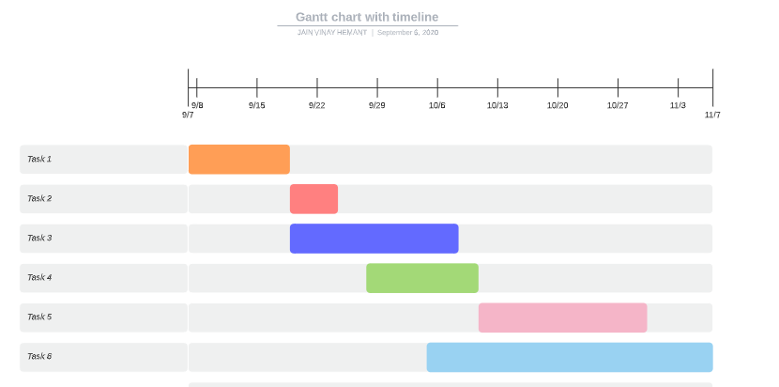
Gantt Chart

Slide 29
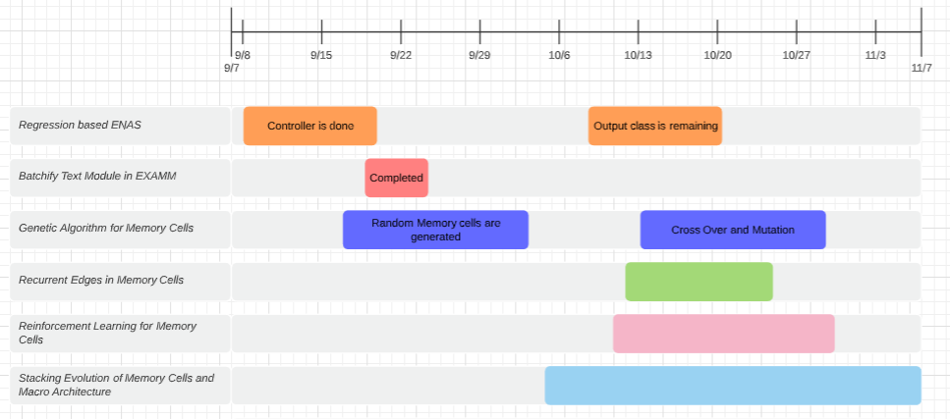
Gantt Chart

Slide 30
Thanks!

